Slide 1
Tutorial 7
Part 2

Slide 2
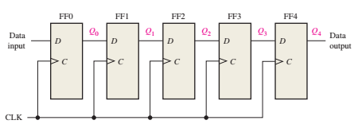

Question 1:
Question 2:

Slide 3
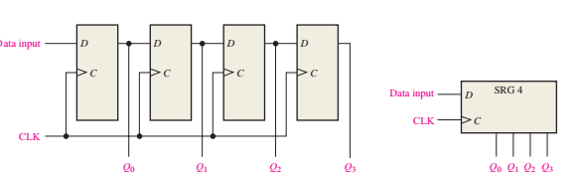

Question 3: Show the states of the 4-bit register. Consider the register contains all 1

Slide 4
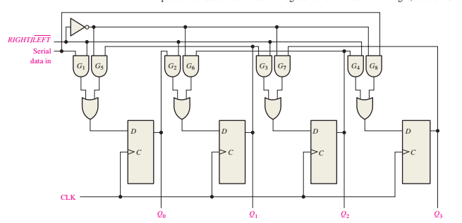

Question 4: Show the state of the bidirectional shift register. Assume Q0=Q1=Q3=1, Q2=0 and the serial data input line is low.

Slide 5
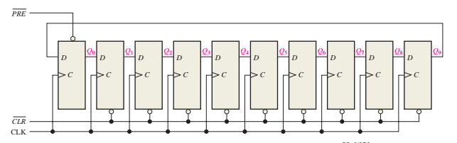


Question 5: A 10 bit ring counter with initial state 1010000000 is shown below. Can you determine the Q outputs for 10 clock pulses.
Question 6:

Slide 6


Question 7: Determine the frequency of the pulses at points W, X, Y and Z in the following circuit
Question 8: Construct a binary counter that will convert a 64 kHz signal into a 2 kHz square wave.
Question 9:

Slide 7
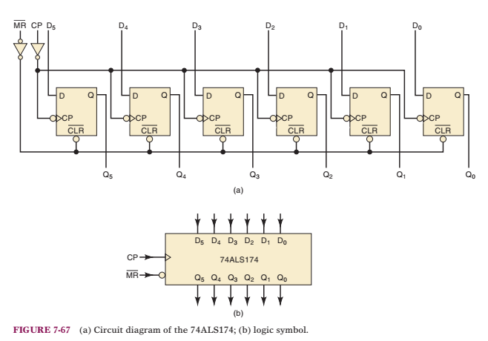
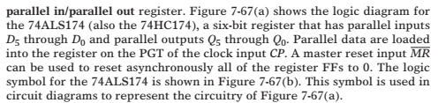
Question 9 cont:

